Slide 1
Powered by
Organised by
18th – 19th August 2021
Sponsorship Dossier

Slide 2
Adapt. Innovate. Win
#TechLeadership in the New Normal
A High-Impact, Invitation-only Exclusive Platform for CXOs driving Digital Transformation and Business Resilience Transformation

Slide 3
Adapt. Innovate. Win
Why is it Irresistible?
Largest platform with over 5000 core IT decision-makers and influencers
Congregation of CXOs who have led technological innovations and transformation initiatives
Stage for client testimony for IT Vendors/OEMs to help them drive customer experience
Largest knowledge-sharing platform for industry leaders and peers
Opportunity to position customer case study for Innovation Awards and Hall of Fame

Slide 4
Summit Highlights
Key Focus Areas
CXO Tech Priorities
Digital Transformation
Cloud Computing
AI & Automation
2
4
3
5
7
1
6
8
Future of Work – Employee Experience
Customer Experience Strategy
Cyber Security
DR and BCP

Slide 5
Summit Highlights
SUMMIT HIGHLIGHTS
20+ Knowledge Sessions | 500 + CIO & ITDM | 5000 + Attendees | 08+ Hours of Networking
The summit will consist of interesting panel discussions, insightful keynotes, exclusive fireside chats, business chats, CXO master classes and engaging industry presentations. | Industry's thought leaders, decision makers and solution providers will gather virtually to discuss the latest trends, innovations, transformation stories and technologies. | Congregation of industry's top-level executives and senior executives for knowledge sharing. | Networking opportunity for solution and service providers with industry's top decision makers via digital experience zone, public chat, private chats and roundtable discussions.

Slide 6
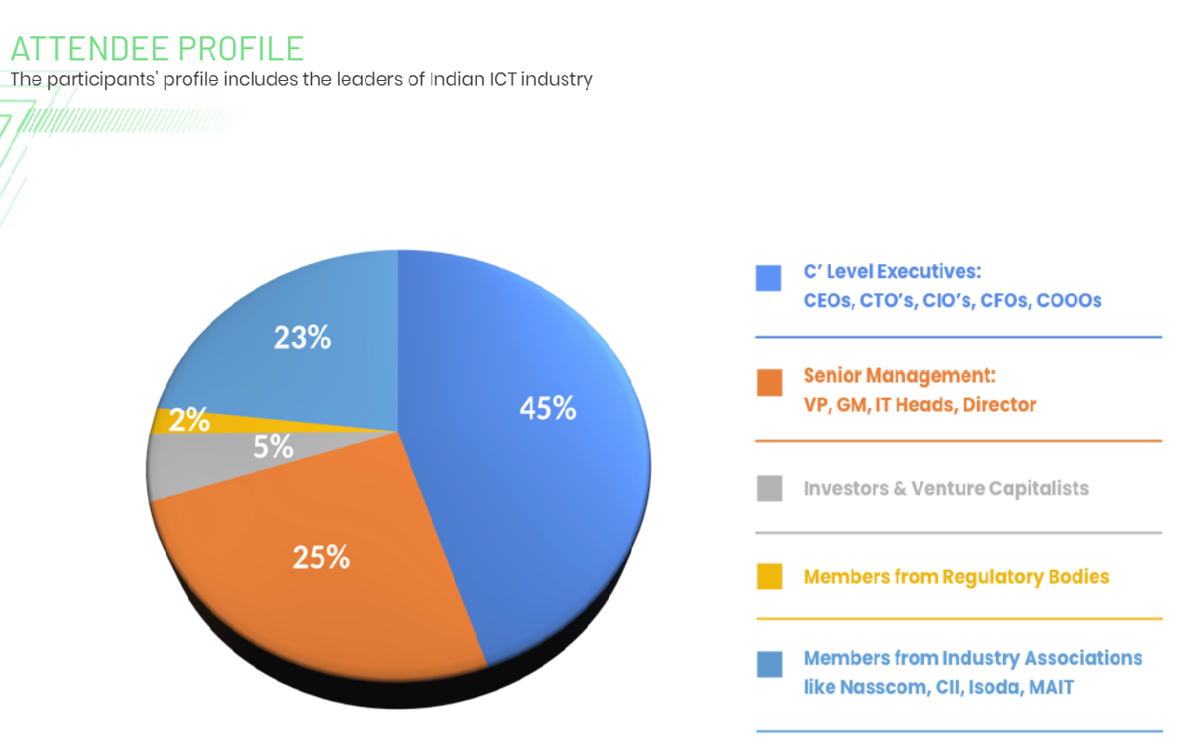
Attendee Profile

Slide 7
Title Partner
Deliverables:
Status as ‘Presenting Partner’ (Exclusive)
20 mins Speaking Slot to address the entire audience
One seat on the relevant panel discussion of 45-60 mins
e-Stall space to showcase your brand to all the attendees
EDM to 67,000+ ITDM (CIO, CTO, CISO, CMO, CSO, CDO etc)
1 Month (300x250) MPU advertisement on CXOtv Website
Complete database of all the attendees
Brand presence in all event-related communications
Brand presence at the virtual Venue [backdrop, tent cards, and all other brandings]
Brand presence [Logo] in the delegate kit, agenda and other communications
Title Sponsor
INR 20 Lacs

Slide 8
Gold Partner
Deliverables:
Status as ‘Gold Partner’ (Max 2)
10 mins Speaking Slot to address the entire audience
One seat on the relevant panel discussion of 45-60 mins
e-Stall space to showcase your brand to all the attendees
EDM to 67,000+ ITDM (CIO, CTO, CISO, CMO, CSO, CDO etc)
Complete database of all the attendees
Brand presence in all event-related communications
Brand presence at the Virtual Venue [backdrop, tent cards, and all other brandings]
Brand presence [Logo] in the delegate kit, agenda and other communications
Gold Partner
INR 15 Lacs

Slide 9
Associate Partner
Deliverables:
Status as ‘Associate Partner’
Presentation of 7 mins
One seat on the relevant panel discussion of 45-60 mins
e-Stall space to showcase your brand to all the attendees
EDM to 67,000+ ITDM (CIO, CTO, CISO, CMO, CSO, CDO etc)
Complete database of all the attendees
Brand presence in all event-related communications
Brand presence at the virtual Venue [backdrop, tent cards, and all other brandings]
Brand presence [Logo] in the delegate kit, agenda and other communications
Associate Partner
INR 12 Lacs

Slide 10
THANKS YOU
https://techplusmedia.com/cxotv/CIOawards2020/

