Slide 1
Powered by
Organised by
10th June 2022 | Radisson Mumbai
Sponsorship Dossier

Slide 2
Theme : From Edge to Cloud
Most Result-Oriented CIO Event of the Year
An invitation-only platform for CXO’s leading Customer Experience and Digital Transformation
Why is it irresistible?
Platform with over 200+ core IT Decision-makers and influencers
Congregation of CXOs who have led technological innovations and transformation initiatives
Stage for client testimony for IT Vendors/OEMs to help them drive customer experience
Knowledge-sharing platform for industry leaders and peers
Opportunity to position customer case study for Innovation Awards and Hall of Fame

Slide 3
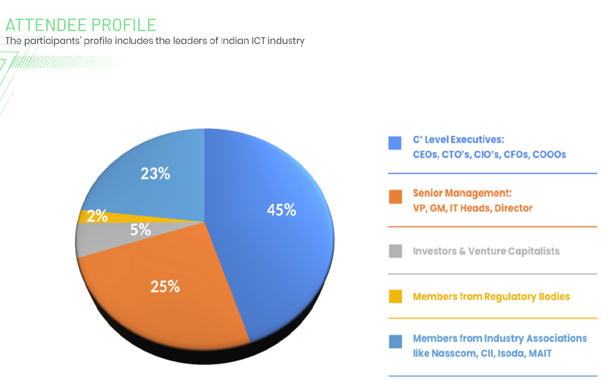
Attendee Profile

Slide 4
Summit Highlights
SUMMIT HIGHLIGHTS
7+ Knowledge Session | 150 + CIO & ITDM | 200 + Attendee | 07+ Hours of Networking
The summit will consist of interesting web panel discussions, exclusive live fireside chats and engaging digital industry presentations. | Industry's thought leaders, decision makers and solution providers will gather virtually to discuss the latest trends, innovations and technologies | Congregation of industry's top-level executives and senior officials for knowledge sharings | Networking opportunity for solution and service providers with industry's top decision makers via digital exhibition, public live chats and private one-on-one chats.

Slide 5
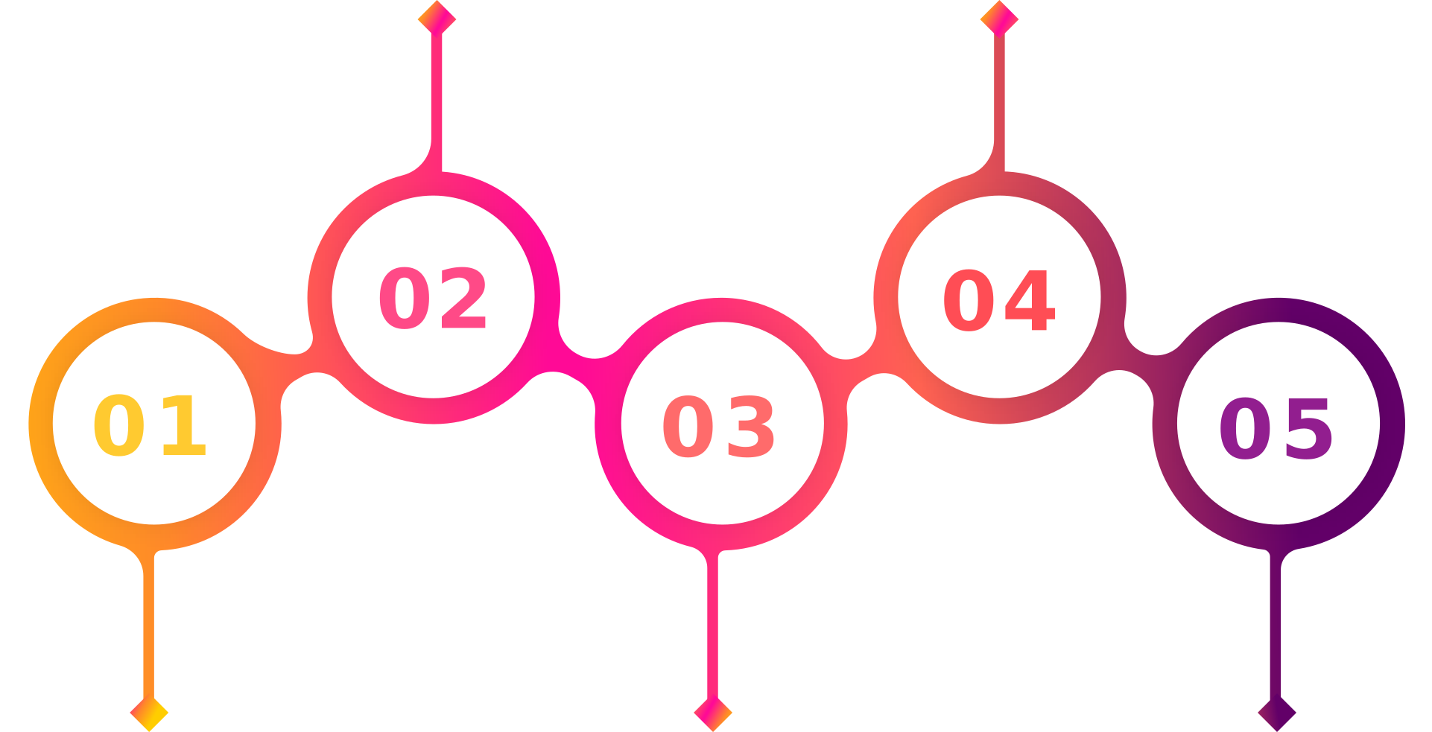
Summit Highlights
Why should you attend?
Attend exclusive interactive sessions with opportunities to interface with industry leaders
Hear Senior industry leaders discuss their programs and business challenges
Hear ideas from Expert speakers to identify the challenges, create a digital strategy and incubate solutions
Expand your knowledge, as Pioneers, Gurus, Experts and solution providers share their latest research and findings
Opportunity to Network, discuss challenges, and share ideas

Slide 6
Title Partner
Deliverable:
Status as “Presenting Partner” (Exclusive)
15 mins Keynote Slot to address all the audience
One seat on the relevant panel discussion of 45 mins
EDM to 43,000+ ITDM ( CIO , CTO , CISO , CMO , CSO , CDO etc)
1 Month (300x250) MPU advertisement on CXOtv Website
Complete database of all the attendee
Brand presence in all event related communication
Brand presence at the Virtual Venue [Backdrop, tent cards, and all other branding]
Brand presence [Logo] in the delegate kit, Agenda and other communication
Title Sponsor
INR 15 Lacs

Slide 7
Gold Partner
Deliverable:
Status as “Gold Partner” (Max 2)
8 mins Speaking Slot to address all the audience
One seat on the relevant panel discussion of 45 mins
EDM to 67,000+ ITDM ( CIO , CTO , CISO , CMO , CSO , CDO etc)
Complete database of all the attendee
Brand presence in all event related communication
Brand presence at the Virtual Venue [Backdrop, tent cards, and all other branding]
Brand presence [Logo] in the delegate kit, Agenda and other communication
Gold Partner
INR 12 Lacs

Slide 8
Associate Partner
Deliverable:
Status as “Association Partner”
Presentation of 5 mins
One seat on the relevant panel discussion of 45 mins
EDM to ITDM ( CIO , CTO , CISO , CMO , CSO , CDO etc)
Complete database of all the attendee
Brand presence in all event related communication
Brand presence at the Virtual Venue [Backdrop, tent cards, and all other branding]
Brand presence [Logo] in the delegate kit, Agenda and other communication
Associate Partner
INR 9 Lacs

Slide 9
THANK YOU

